Slide 1
Automated irrigation System
Presented by :
MD. Abdullah Sayket : 2014-3-60-036
MD.Ashik Mahmud : 2014-3-60-040
MD. Enamul Haque : 2015-1-60-090
Presented To :
Dr. MD Nawab Yousuf Ali
Associate Professor
CSE Dept.
East West University

Slide 2
Overview
Introduction
Objective
Problem faced in Agriculture
Required Elements
Block Diagram
Project Procedure
Merits
Conclusion and future work

Slide 3
Introduction
Irrigation is the artificial application of water to the land or soil.
It is used to assist in the growing of agricultural crops, maintenance of landscapes and revegetation of disturbed soils in dry areas and during periods of inadequate rainfall.
Knowing when and how much to water is two important aspects of watering process.
To make the farming works easily, the automatic irrigation system is created.
3

Slide 4
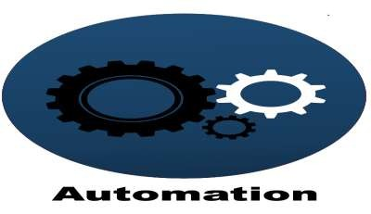

Objective
To minimize manual intervention by the farmer.
To check the moisture level in the soil and if moisture level is low then Arduino switches On a water pump to provide water to the plant.
To make water pump automatically off when system finds enough moisture and water overflow in the soil.
To prevent excessive wastage of water, electricity.
4

Slide 5
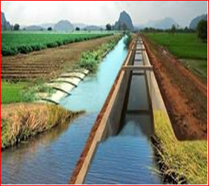
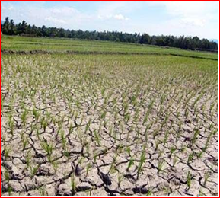
Problems faced in Agriculture
Over Irrigation
Under Irrigation
If farm, lands or fields are situated miles away from our home. Extensive travel required, sometimes several times in a day start and stop the irrigation water pumps.
If land is more , then we need more manpower
5

Slide 6
Required Elements
Arduino
Soil Moisture Sensor
Mini Water Pump
Pipe for Pump
Water sensors
Motor/pump
Power supply
USB connector

Slide 7

Arduino
The Arduino Board is programmed using the Arduino IDE software
It has 14 digital input/output pins (of which 6 can be used as PWM outputs), 6 analog inputs, a USB connection, a power jack, an ICSP header, and a reset button.

Slide 8
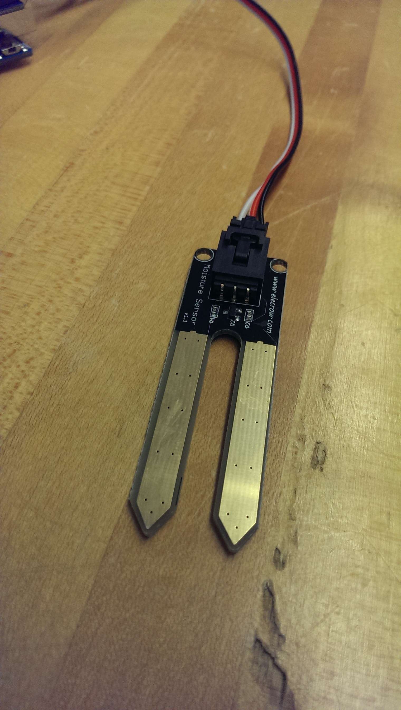
Moisture sensor
Soil moisture sensors measure the water content in soil. A soil moisture probe is made up of multiple soil moisture sensors.
Soil electrical conductivity is simply measured using two metal conductors spaced apart in the soil except that dissolved salts greatly alter the water conductivity and can confound the measurements.
The soil electrical conductivity sensitive to variations in soil salinity and temperature as well as water.

Slide 9
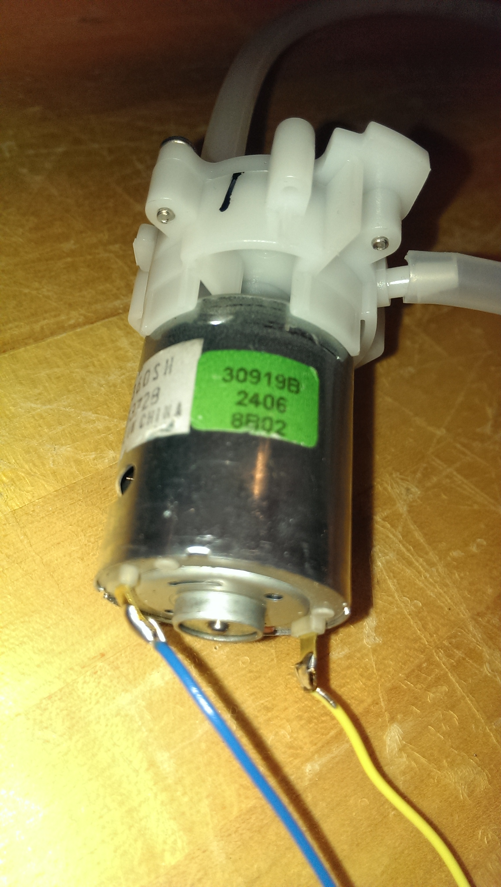
Pumps
The water pump is used to artificially supply water for a particular task.
It can be electronically controlled by interfacing it to a microcontroller.
It can be triggered ON/OFF by sending signals as required. The process of artificially supplying water is known as pumping.

Slide 10
BLOCK DIAGRAM
Probes in soil
Water level sensor
Arduino
Moisture sensor
Relay
DC motor
Power supply 1
Power supply 22

Slide 11
Start
Receive signals from soil moisture sensor
Compare the value from the moisture sensor with desired set
If soil is dry
If soil is wet
Start irrigation
Check the moisture of the soil
System find enough moisture in the soil
Water overflow the soil
Stop irrigation

Slide 12
WORKING Procedure
This project uses Arduino Uno to controls the motor. The Arduino Board is programmed using the Arduino IDE software.
The moisture sensor measures the level of moisture in the soil and sends the signal to the Arduino if watering is required.
The motor/water pump supplies water to the plants until the desired moisture level is reached.

Slide 13
SIGNIFICANCE OF THE PROJECT
Irrigation in fields.
Irrigation in garden,parks.
Very useful for people who do not have time to water their plants because of busy life schedule.
The project is very economical in terms of cost and power.

Slide 14
MERITS
This makes increase in productivity
Reduces water consumption
Reduces manpower
Much land will be irrigated
Works according to the soil condition
Low cost and reliable circuit

Slide 15
. CONCLUSIONS AND FUTURE SCOPE
The Arduino based automatic irrigation system is simple and precise way of irrigation. Hence,this system is very useful as it reduces manual work of the farmers and also helps in the proper utilization of resources. It eliminates the manual switching mechanism used by the farmers to ON/OFF the irrigation system.
This project can be extended to greenhouses where manual supervision is less. Fully automated gardens and farm lands can be created using this principle in the right manneron large scale.

Slide 16


Slide 17
REFERENCES
[1]G. Dearib, Cooperative Automatic IrrigationSystem using Arduino.International Journal of Scienceand Research 6(3)2017, 1781-1787.
[2]S. Rakshak , Prof. R. W. Deshpande, Automated Irrigation System Based on Arduino Controller Using Sensors. International Journal of Innovative Research in Computer and Communication Engineering 5(7), 2017, 13394-13400.
[3]H.T Ingale,N. Kasat, Automated Irrigation System”, Proceedings of the International Journal of Engineering Research and Development, 4(11),2012.

